Slide 1

🌍 Meteor Impact Simulator – NASA Space Apps Challenge 2025
Hackathon Theme: Meteor Madness
Developed by: Team PLUTO
“Simulating Meteor impacts on Earth using data-driven physics and real-time mapping visualization.”

Slide 2


☄️ Understanding the Danger of me Impacts
Earth faces constant risk from Near-Earth Objects (NEOs). Even small asteroids can cause regional devastation, yet interactive tools for real-time impact predictions are lacking.
Constant Risk
Near-Earth Objects pose a continuous threat to our planet.
Regional Devastation
Even smaller impacts can lead to widespread destruction.
Interactive Gap
A need for dynamic tools to visualize impact predictions in real-time.
Challenge Inspired
Our simulator analyzes energy, crater size, and global effects.

Slide 3





🌎 What We’re Trying to Accomplish?
Our goal is to create a web-based simulator for asteroid impacts, allowing users to input parameters and visualize the consequences.
Web-Based Simulator
Calculates and visualizes asteroid impacts online.
Input Parameters
Diameter, velocity, and trajectory (latitude, longitude).
Display Results
Crater size, seismic magnitude, and global heatmap of affected areas.
Educate Users
Inform about real-world asteroid effects and risks.

Slide 4


🧠 Meteor Impact Workflow
The system processes user input through a frontend, backend, and physics calculations, then visualizes the output on a map and charts.
User Input
Frontend
Backend
Physics Calc
The frontend collects asteroid data, which the backend (Flask) uses to compute impact energy, crater diameter, and seismic magnitude. Results are then visualized with Chart.js and Leaflet.js map.

Slide 5







💻 Tech Stack & Tools
Our simulator leverages a robust set of technologies for UI, visualization, and backend processing.
Frontend
HTML, React
UI and visualization
Map Visualization
Leaflet.js
Global Earth map with impact zones
Charts
Chart.js
Visualize energy and data outputs
Backend
Node
Handles physics calculations and APIs
Data Flow
REST API (JSON)
Connects frontend & backend
Hosting
Render / Localhost
Runs the web tool

Slide 6
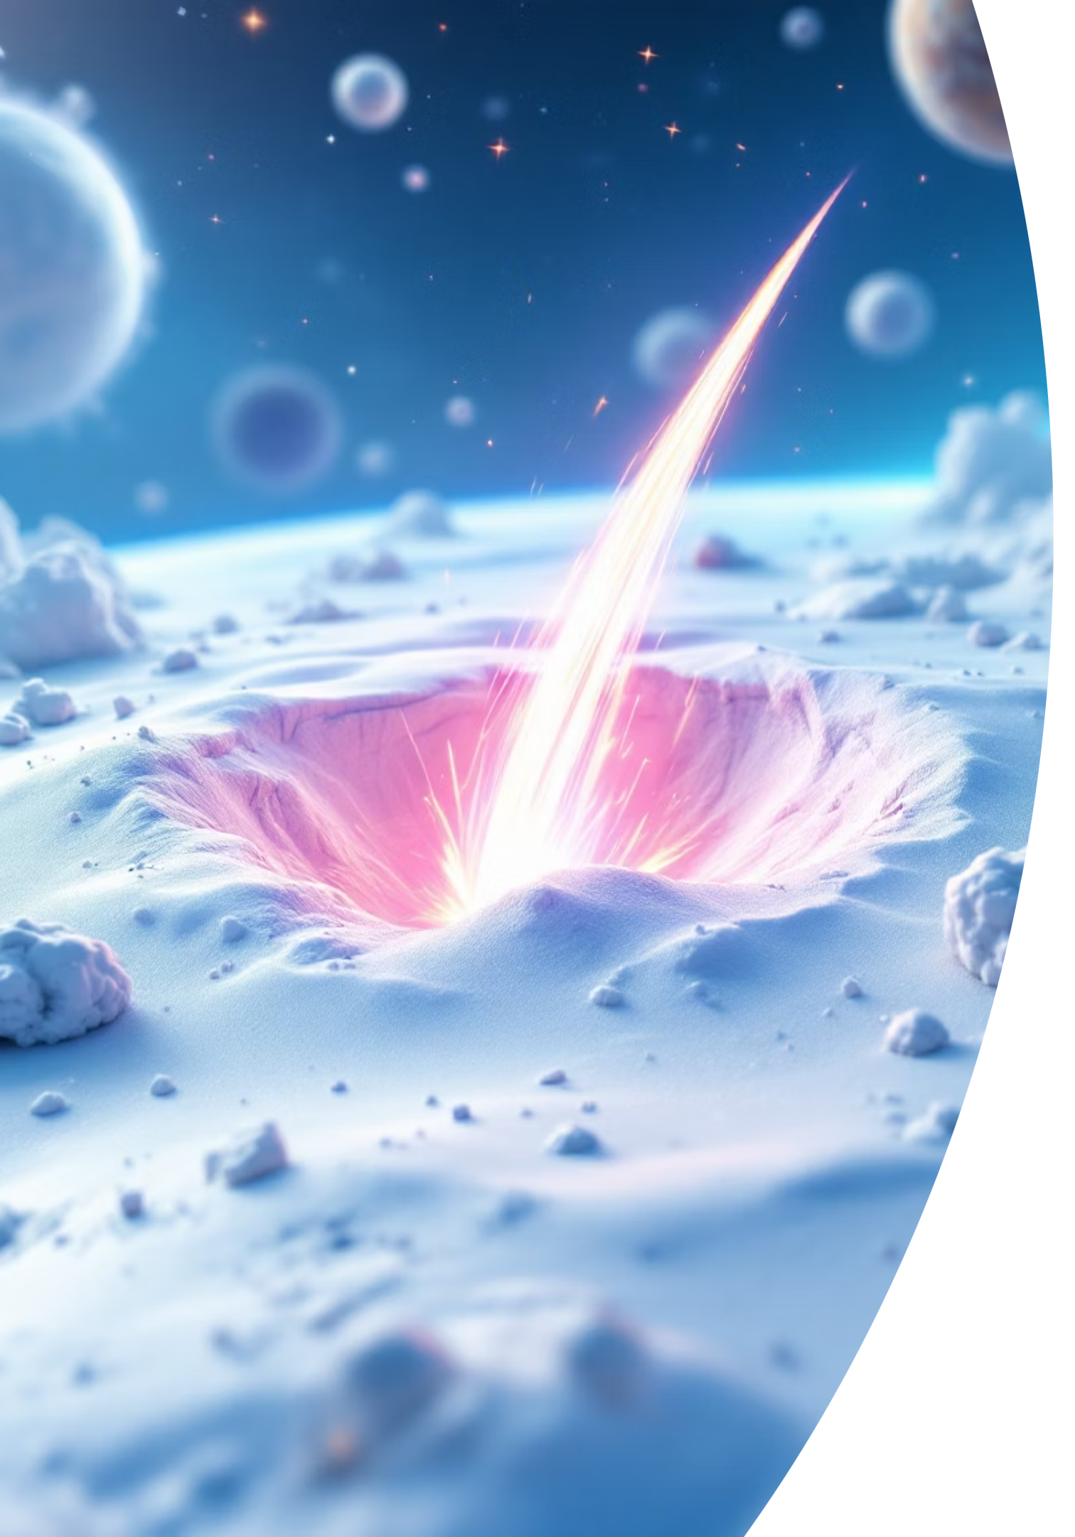



🔬 Physics & Math Model
Our simulator uses simplified models based on NASA/USGS impact studies to dynamically visualize real-world impact zones.
1
2
Impact Energy
Crater Size
Based on established impact energy scaling laws.
Calculated from mass and velocity.
3
Seismic Magnitude
M =0.67 Log10​ (η×2/3*​πr3*ρv2)−5.87
Derived from empirical relations of energy release.

Slide 7

🚀 Impact & Future Vision
We have successfully created an interactive simulation tool, and our future aims to enhance its capabilities and data integration.
Achieved
Future Goals
Real-time asteroid impact simulation tool
Add asteroid database from NASA’s API
Interactive map visualization
Real-time orbit simulation
Supports educational & scientific outreach
Predict atmospheric breakup and tsunami impact

